Slide 1
Data Visualization
Len Kiefer, February 2021

Slide 2
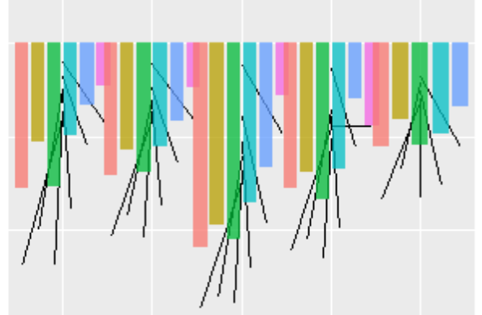
What can be [charted] at all can be [charted] clearly; and whereof one cannot [chart] thereof one must be silent.

Slide 3
Talk overview
Guidelines for better data visualizations
A case study: using data visualization to help talk about how the COVID-19 pandemic has affected the economy and housing markets
Exploratory visualizations versus visualizations to communicate

Slide 4
Data Visualization Guidelines

Slide 5

Five Guidelines from Jon Schwabish’s Better Data Visualizations
Show the Data
Reduce the Clutter
Integrate Graphics and Text
Small Multiples
Start with Gray
https://policyviz.com/2021/02/11/inside-better-data-visualizations-a-guide-for-scholars-researchers-and-wonks/

Slide 6
Using data visualization to help talk about how the COVID-19 pandemic has affected the economy and housing markets

Slide 8
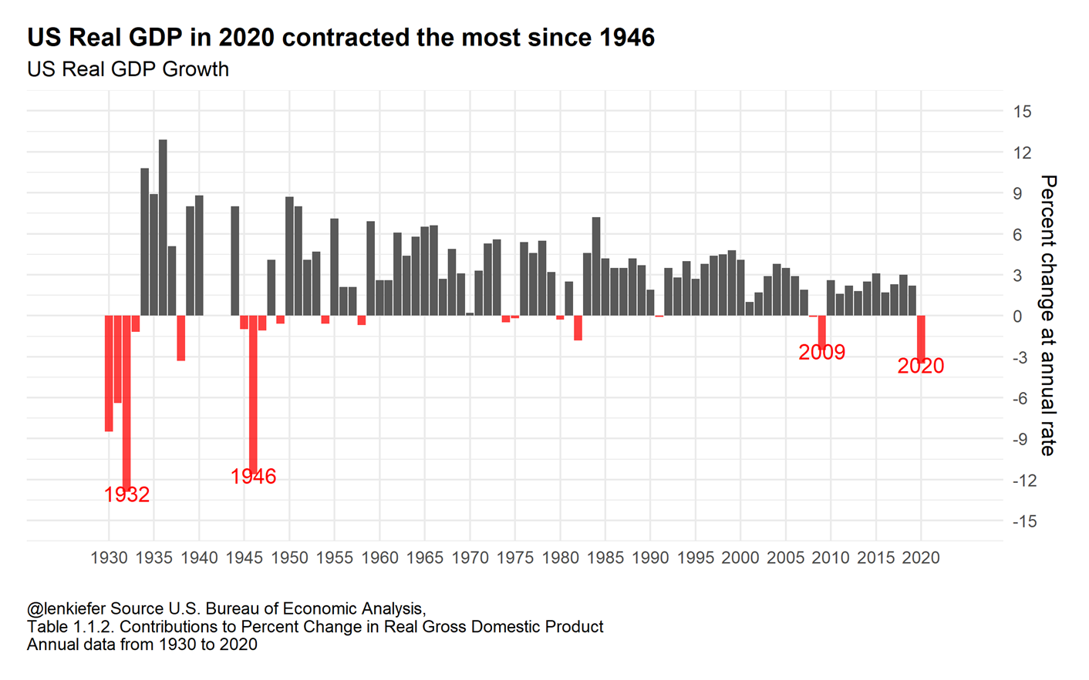
US economy contracts

Slide 9
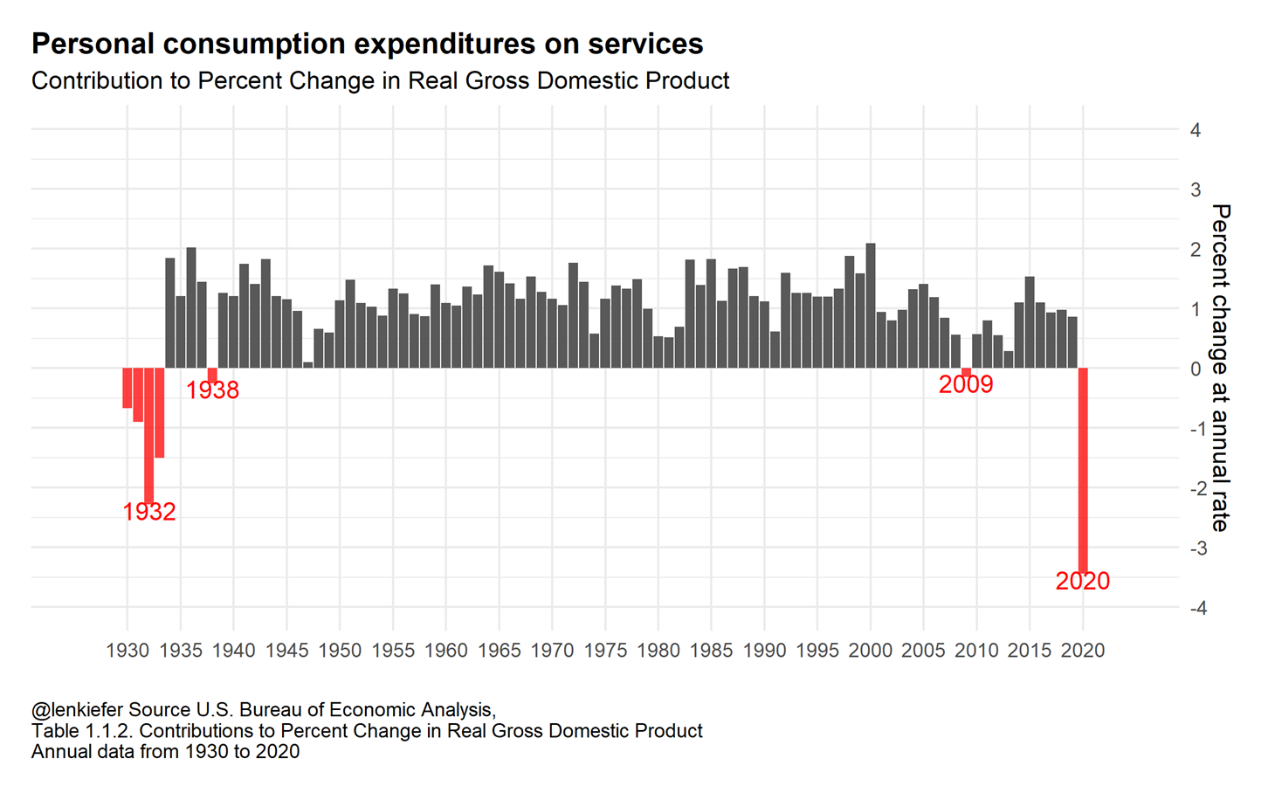
Most of the decline in 2020 GDP was due to contraction in personal consumption expenditures on services

Slide 10
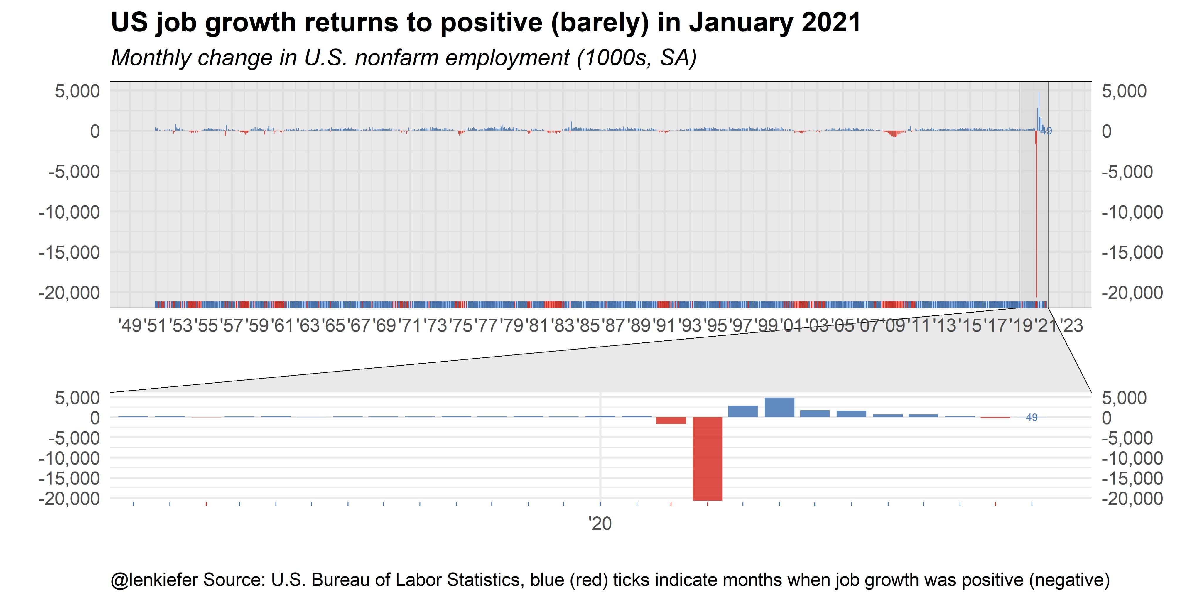
US job growth decelerates

Slide 11
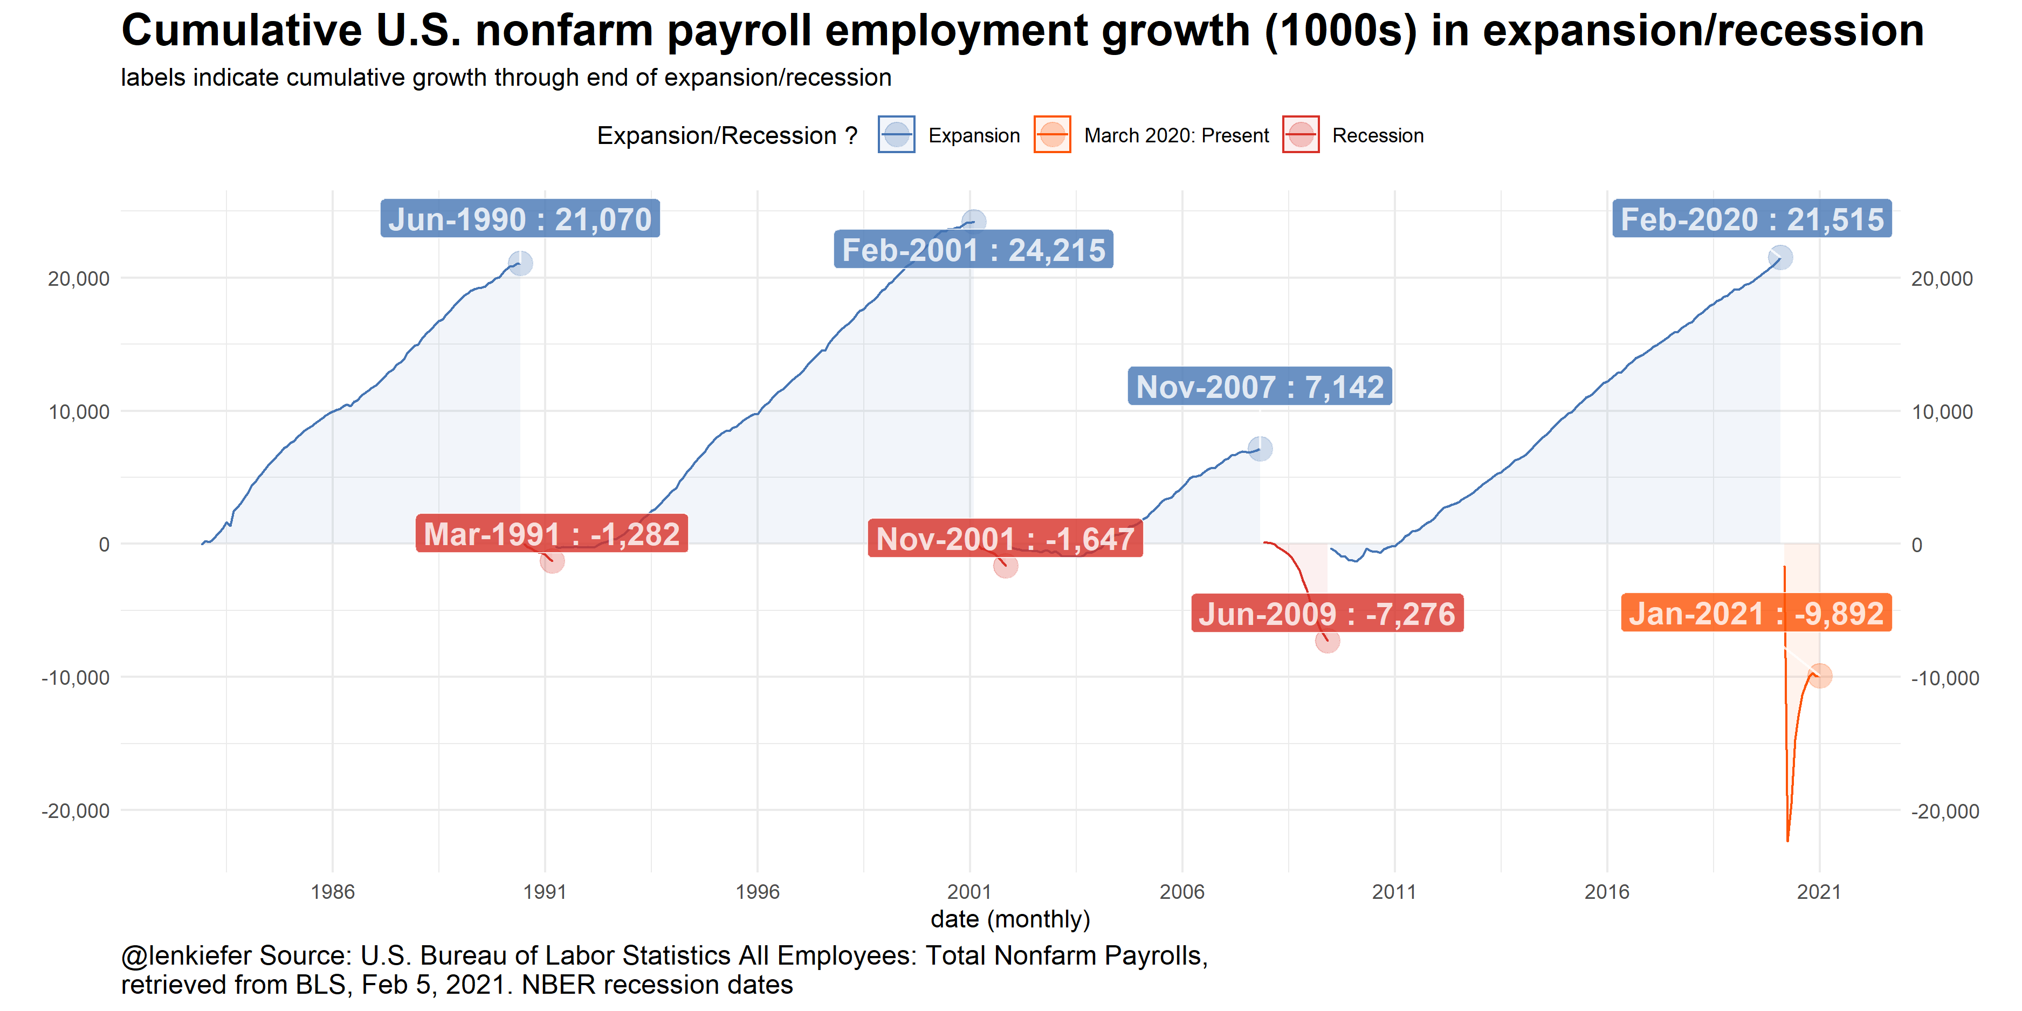
The US economy is down over 9 million payroll jobs since Feb 2020

Slide 12
How did the housing market respond?

Slide 13
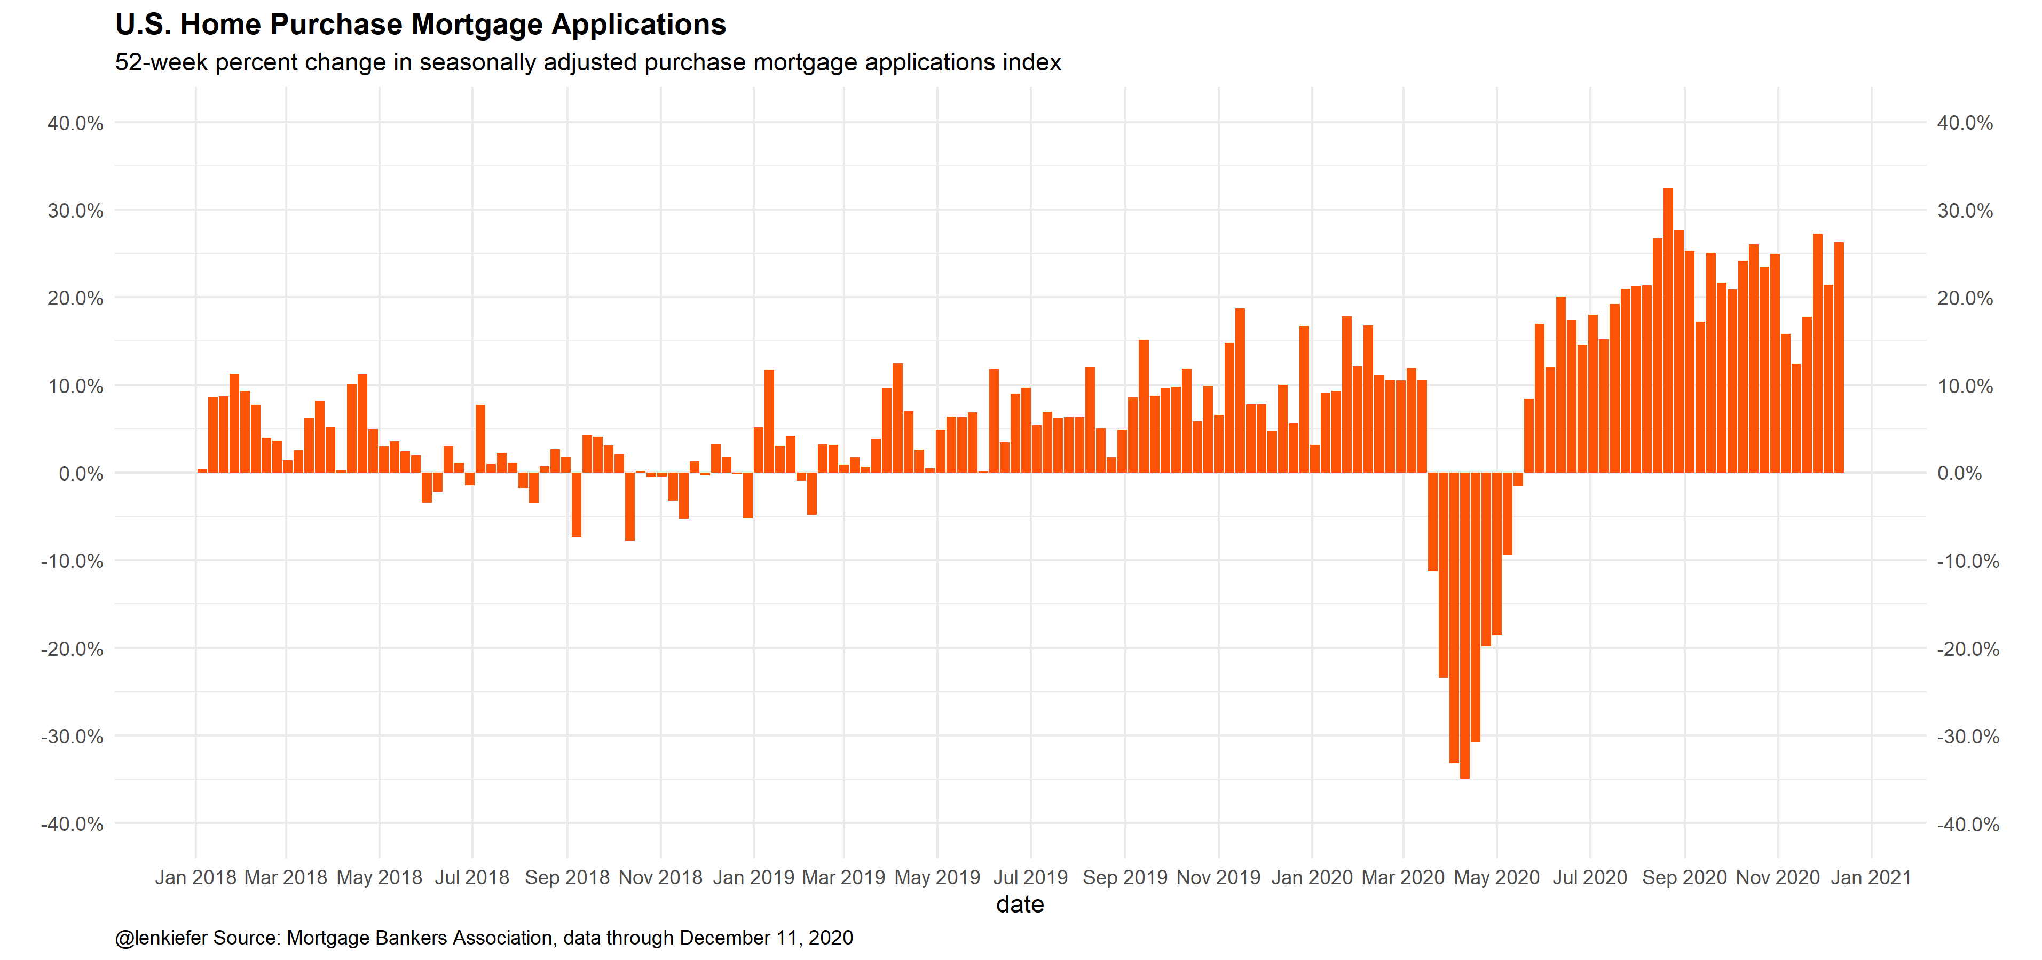

Slide 14
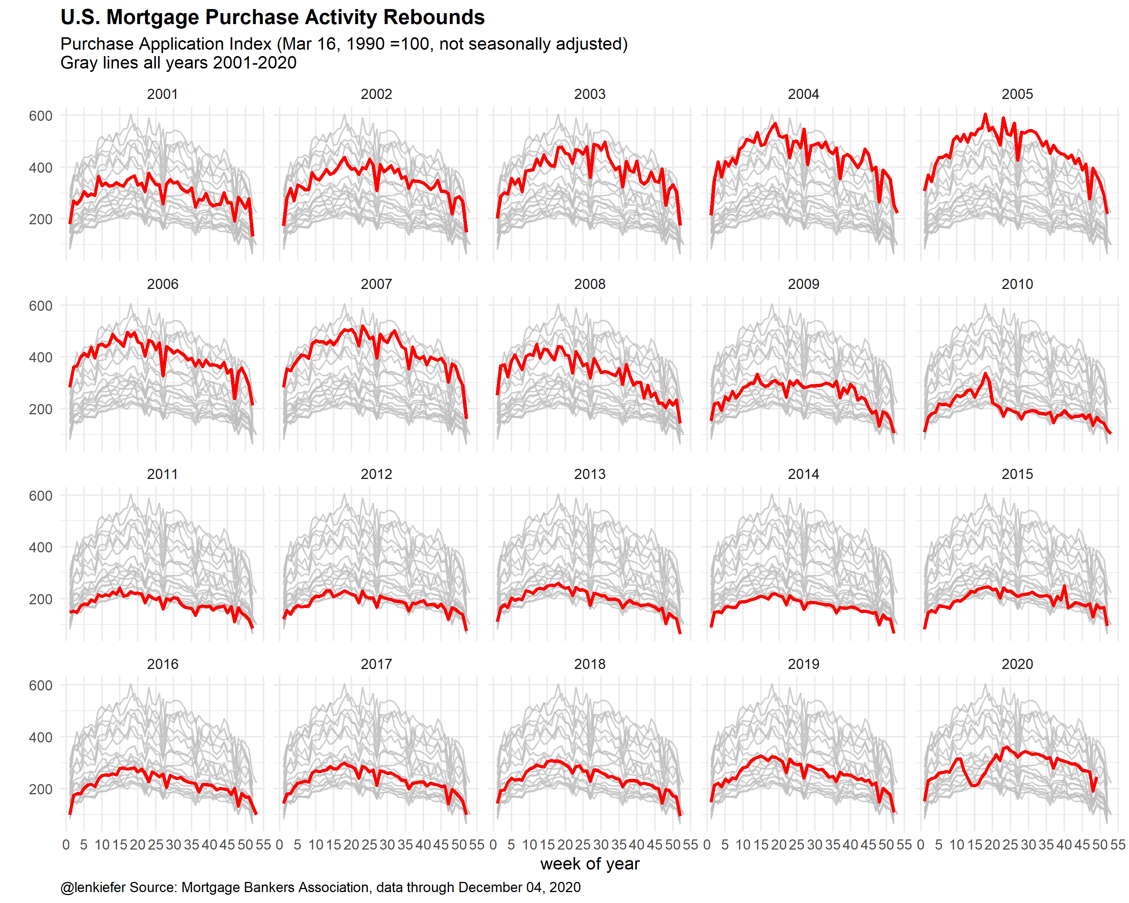

Slide 15
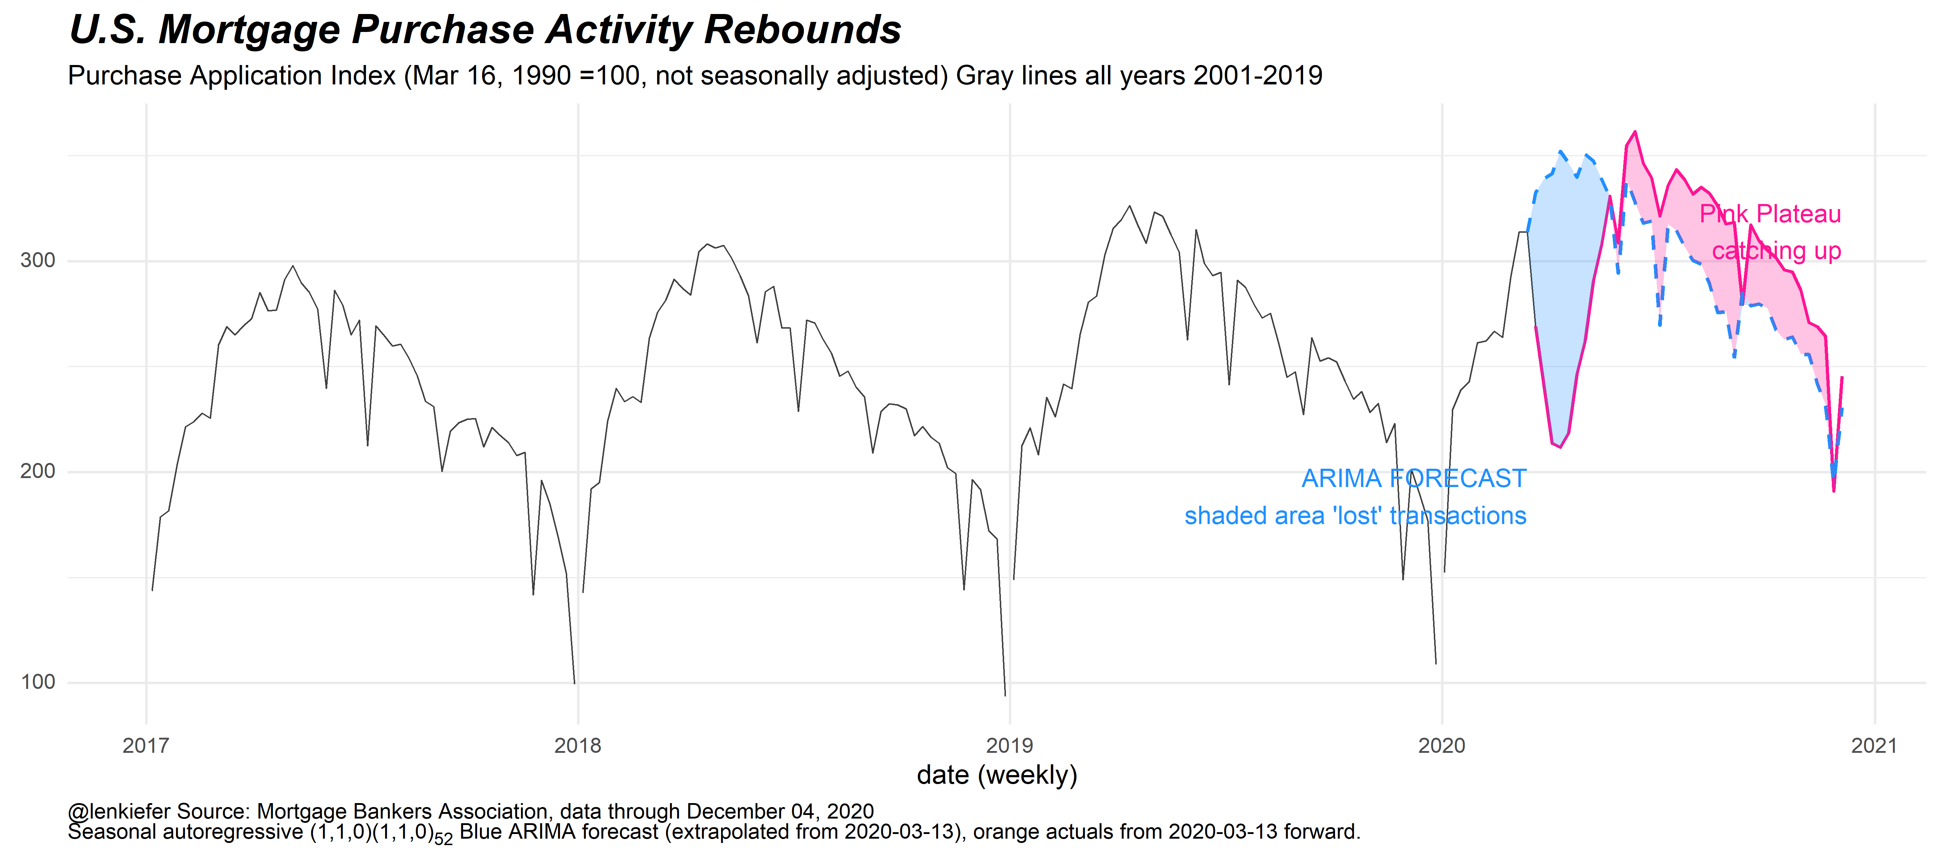

Slide 16
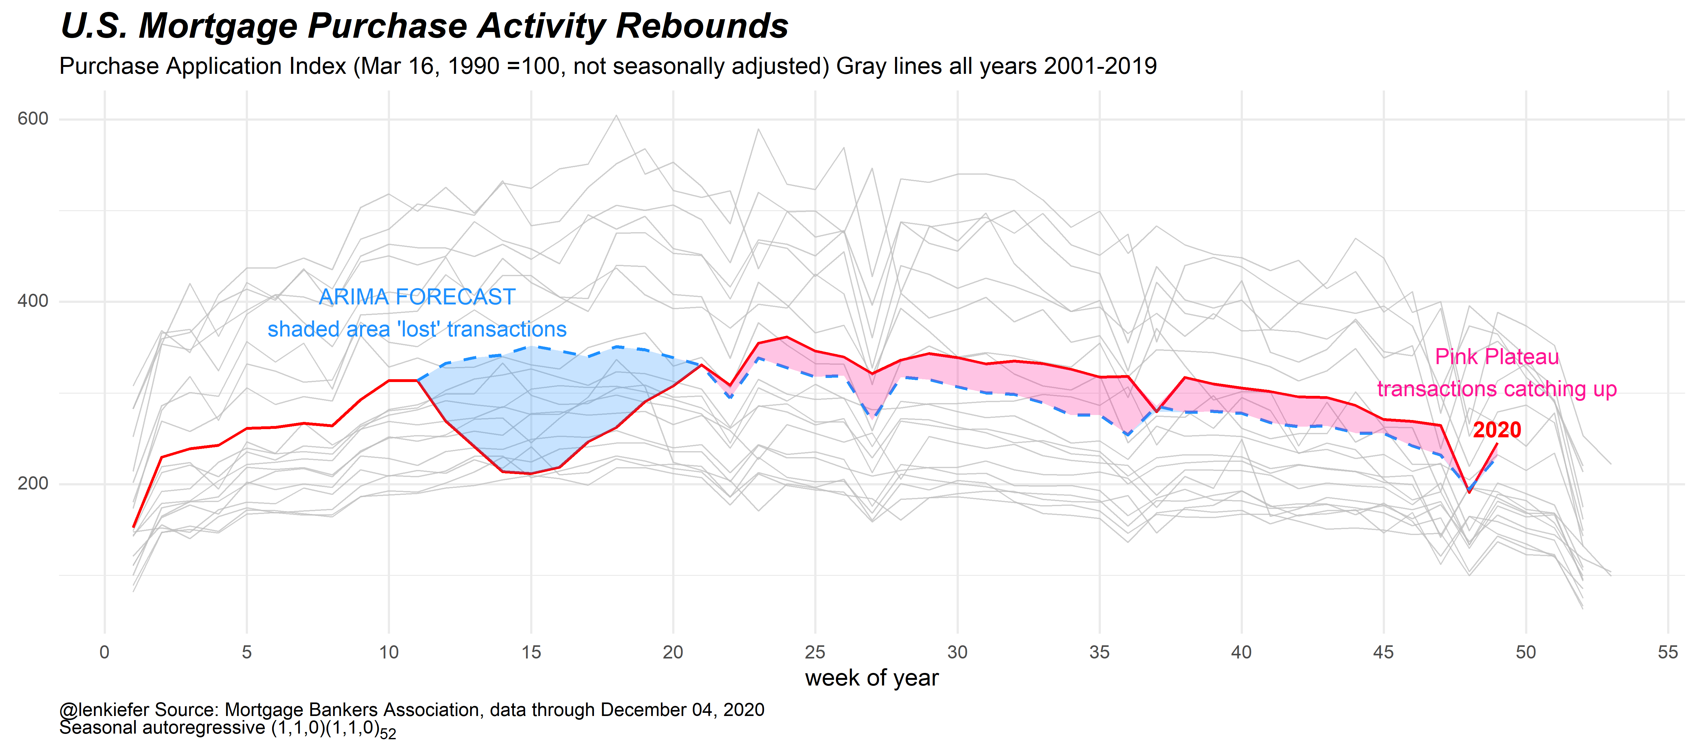

Slide 17
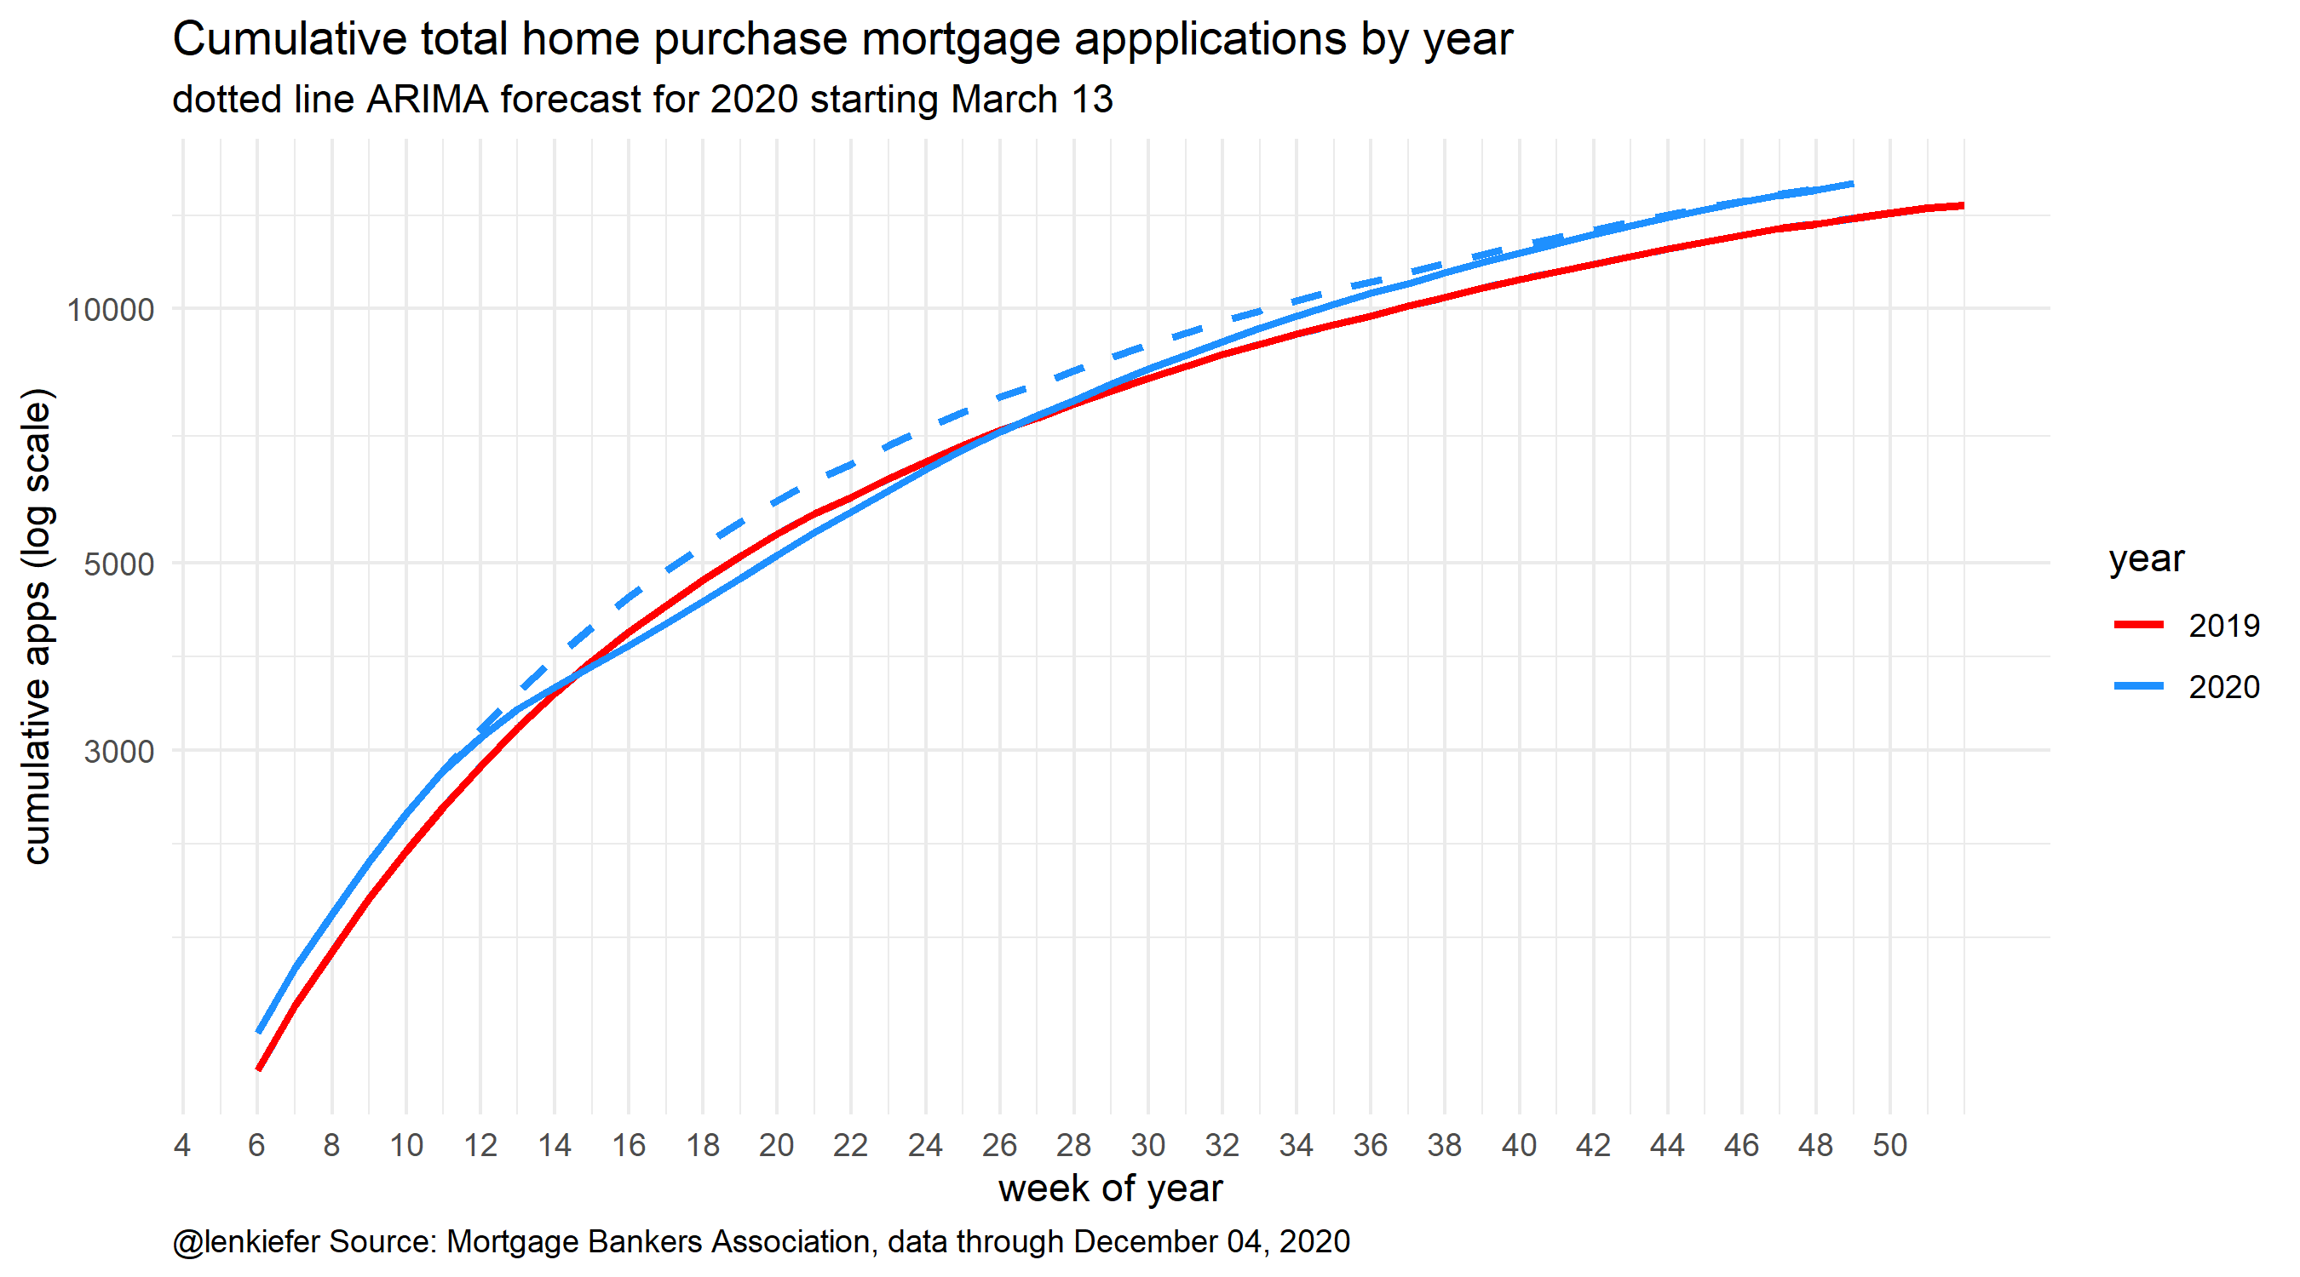

Slide 18
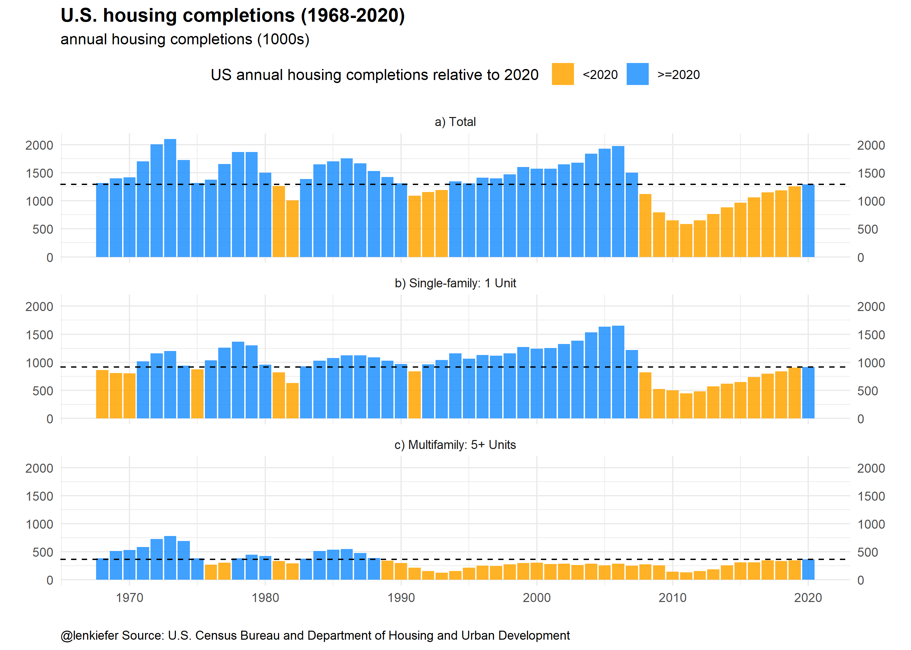

Slide 19
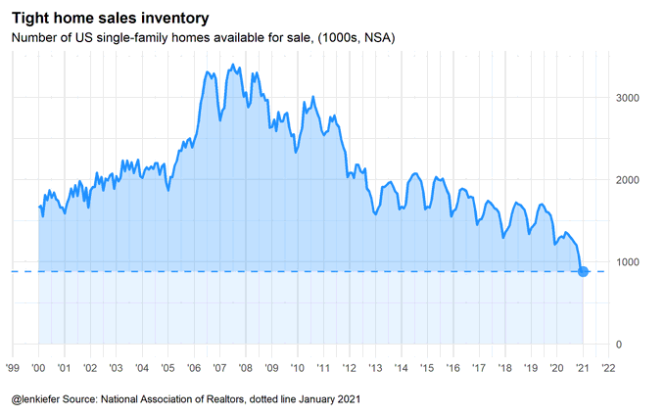

Slide 20
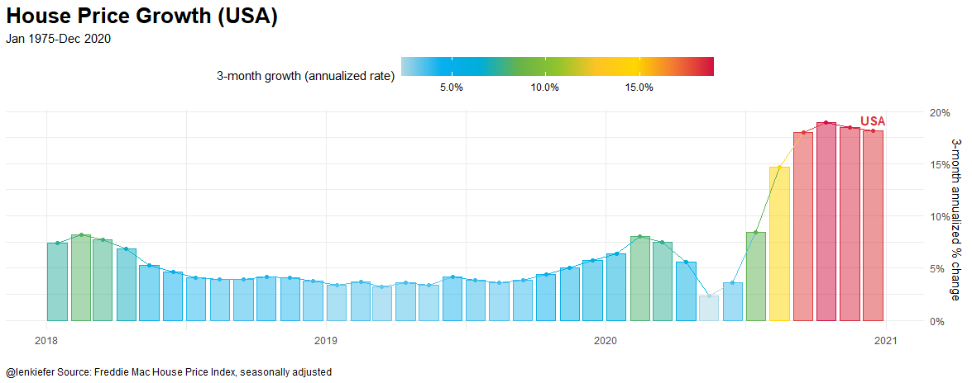

Slide 21
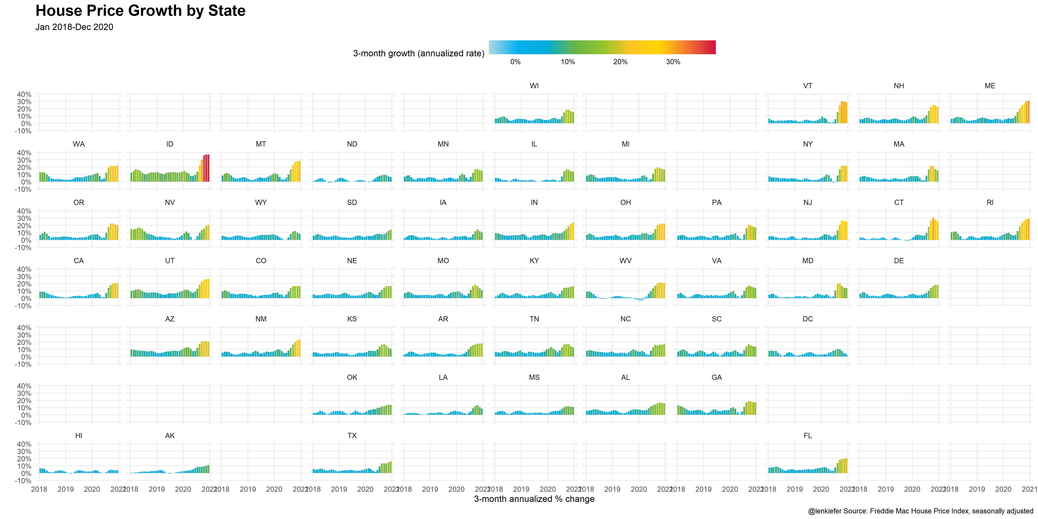

Slide 22
Exploratory vs Explanatory

Slide 23
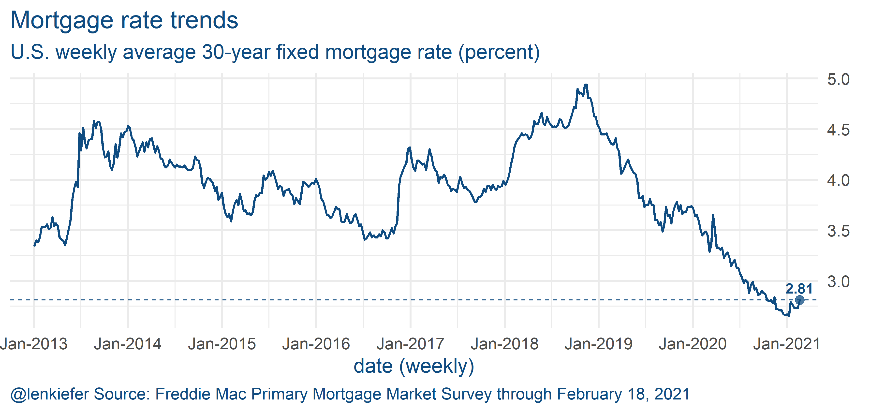

Slide 24
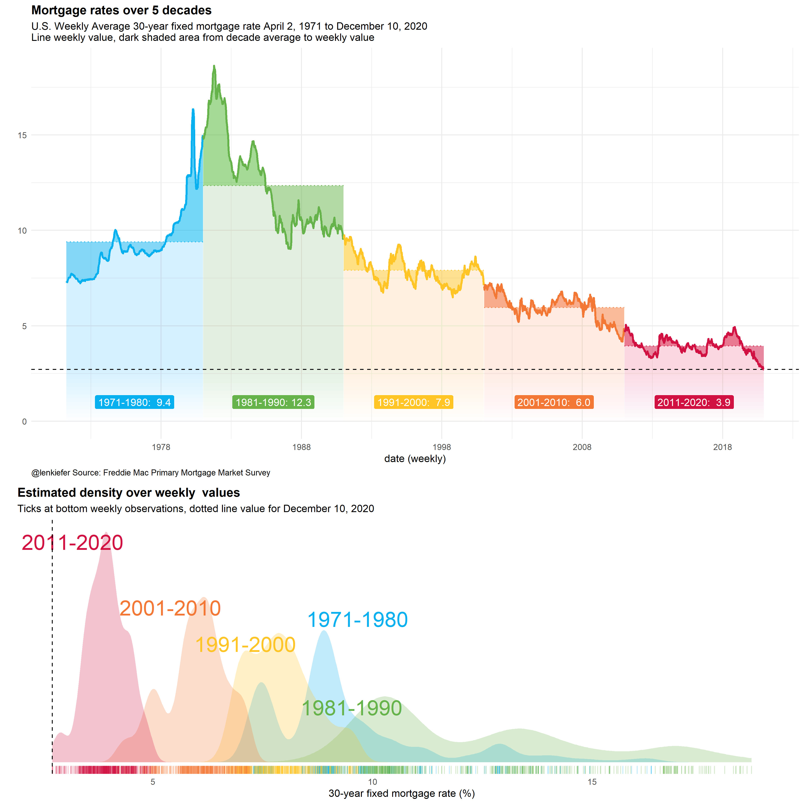

Slide 25
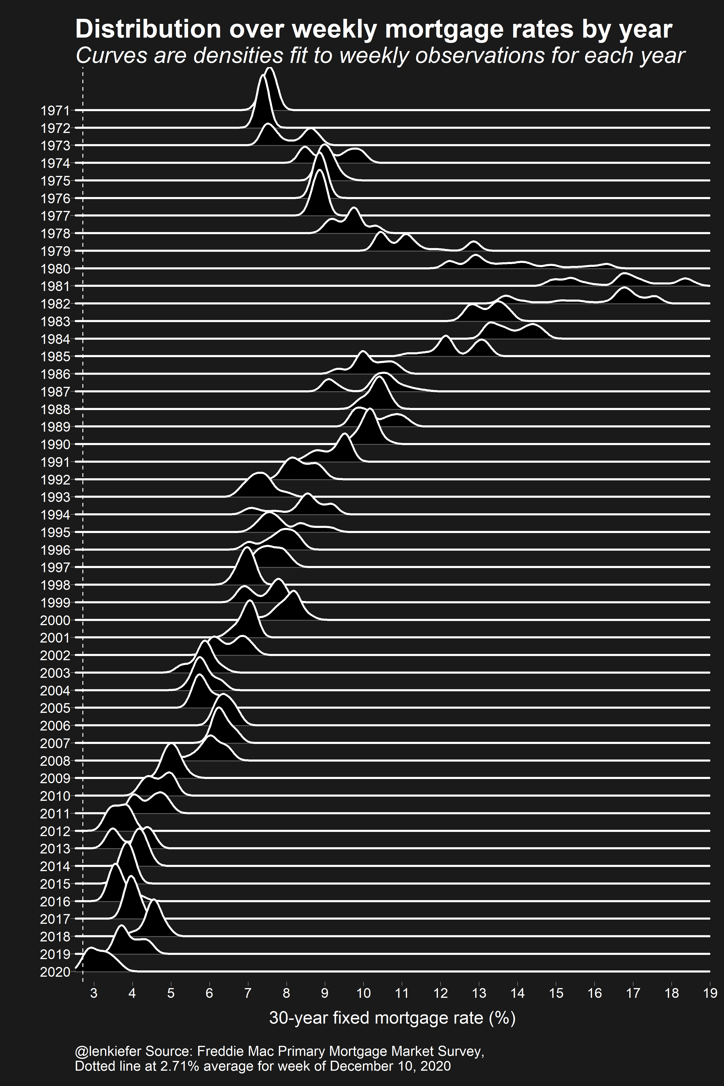

Slide 27
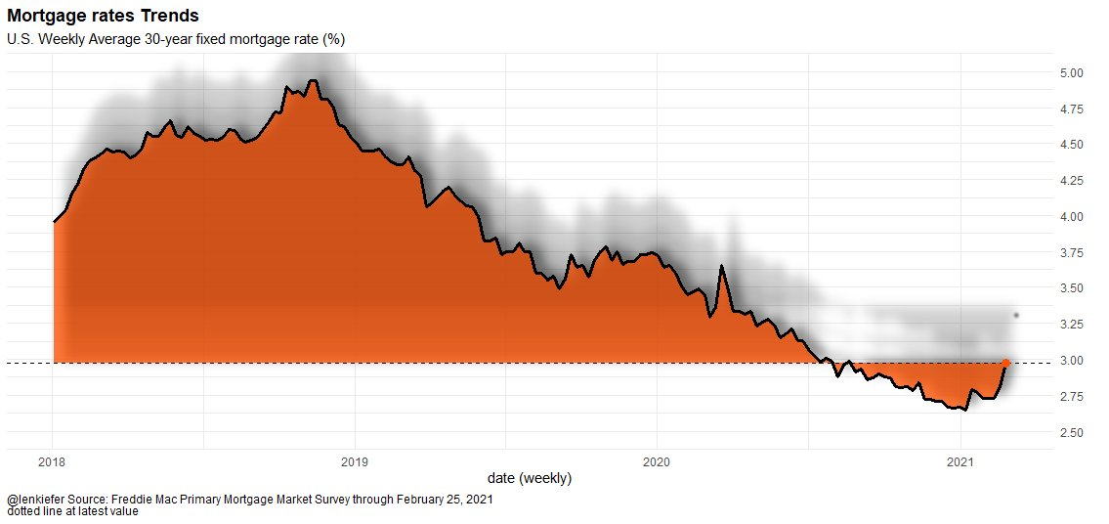
The shadow of higher mortgage rates looms over the housing market

Slide 28
Get more information

Slide 29
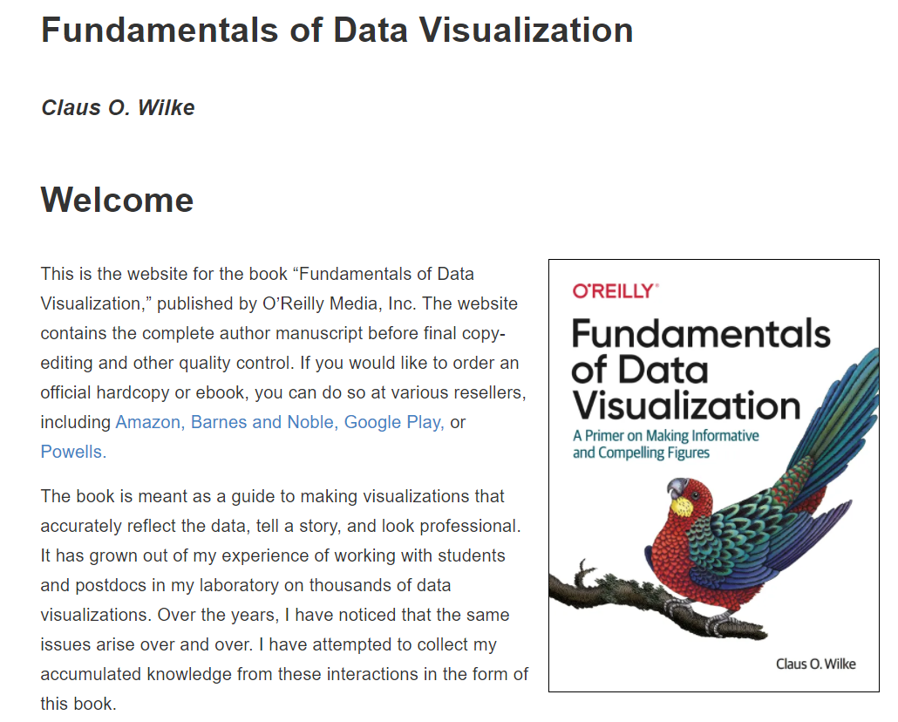
An excellent resource:
https://clauswilke.com/dataviz/

Slide 30
Better Data Visualizations: A Guide for Scholars, Researchers, and Wonks
By: Jonathan Schwabish
Learn about principles of visual perception and data visualization best practices.
Expand your graphic literacy by learning about more than 80 different visualization types.
Learn how to define your audience and goals, and choose the chart, graph, or diagram that best fits for your data.
https://policyviz.com/2021/02/11/inside-better-data-visualizations-a-guide-for-scholars-researchers-and-wonks/

Slide 31
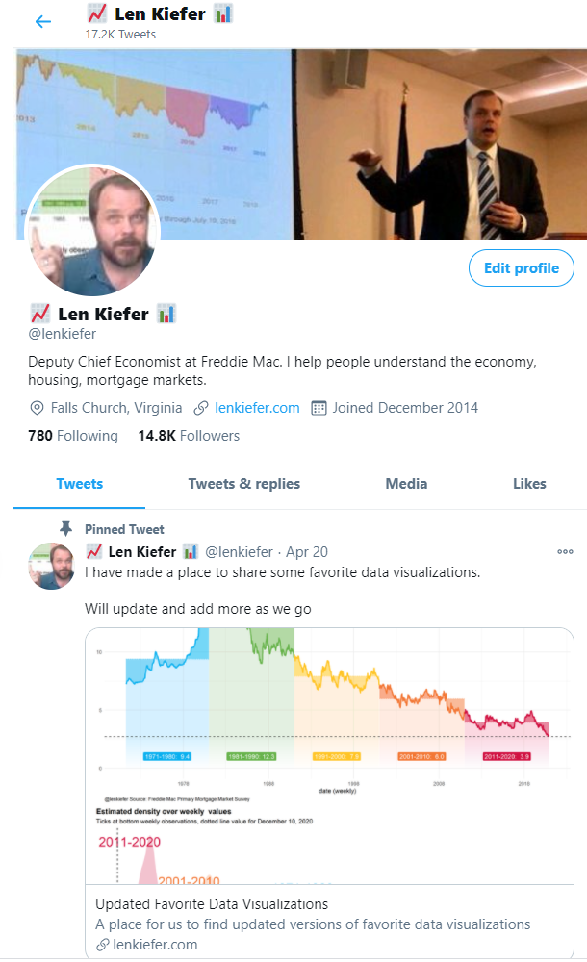
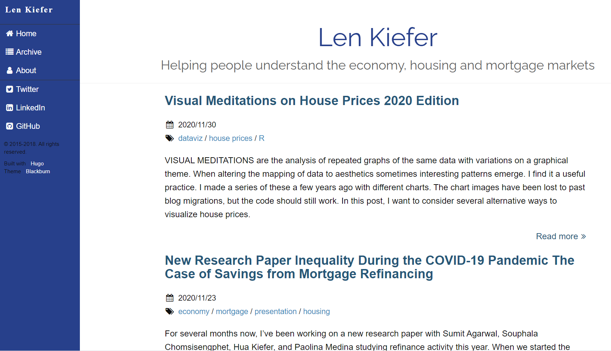
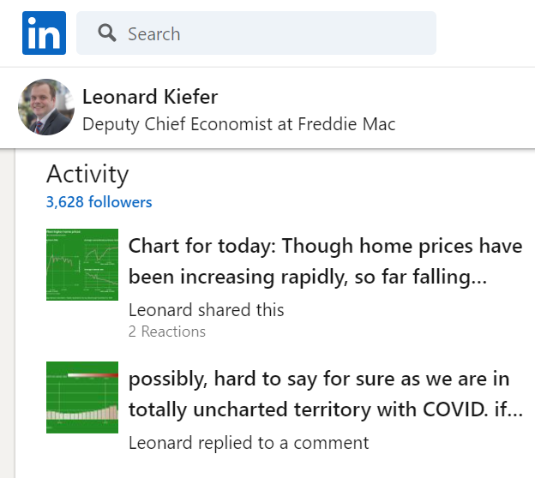
Find reproducible R code at lenkiefer.com, or follow me on Twitter and LinkedIn

